Slide 1
《英语国家社会与文化入门》(下册）
The Society and Culture
of Major English-Speaking Countries
Introduction
(Book Two)

Slide 2
The United States of America Unit 8 Education in the United States

Slide 3
Quiz
Give the English and a brief explanation for the following:
1 小学
2 教育委员会
3 高等教育
4 军人重新安置法案
5 肯定性行动计划 （平权法案）

Slide 4
Focal Points
different education laws for different states
several levels of schooling
curricula for students
compulsory education for all children
equal education opportunities for minority groups
higher education system
varieties of colleges and universities
trends in degree programs
the Servicemen's Readjustment Act
Affirmative Action programs
non-traditional students

Slide 5
This Unit Is Divided into Nine Sections
Going to School in America Today
Education -- A Local Matter
What an American Student Learns
Education in a New Nation
Learning to Be World Citizens
Higher Education
Selecting a College or University
Trends in Degree Programs
Education for All

Slide 6
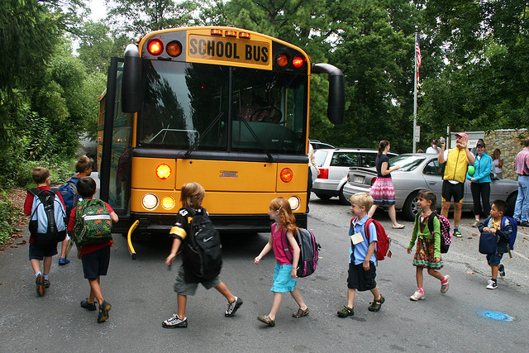
I. Going to School in America Today
• American children go to school from kindergarten to the 12th grade, they attend classes for an average of five hours a day.
• The goal of education – to achieve universal literacy and to provide individuals with the knowledge and skills necessary to promote both their individual and general public welfare.

Slide 7
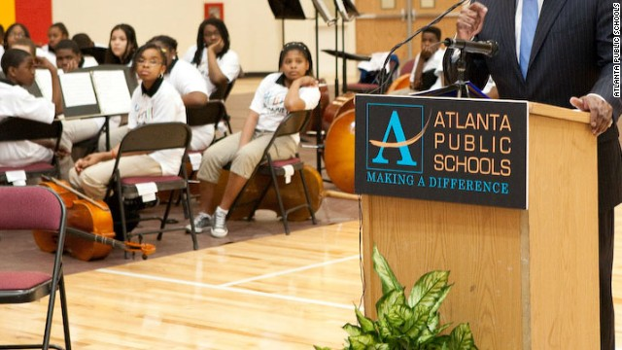
public schools
take up about 90% of American students;
boards of education at the state and/or district level guide the spending, make decisions about the school curriculum, teacher standards and certification, and the overall measurement of student progress

Slide 8
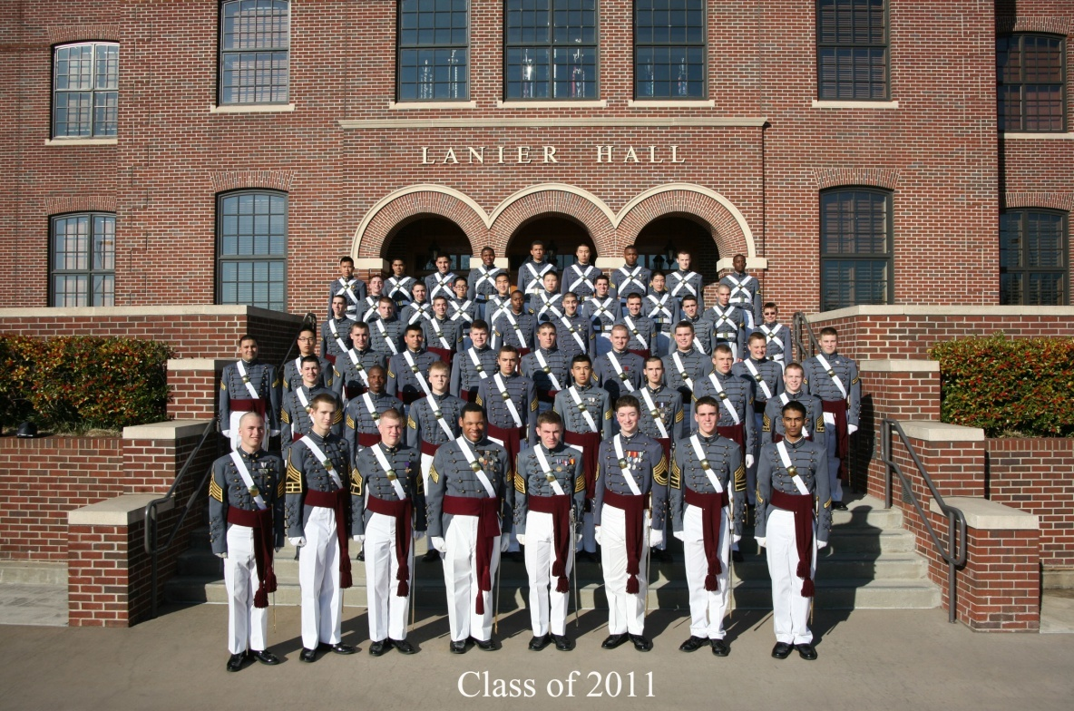
private schools
take up slightly over 10%;
have the freedom to use the fees they collect and make decisions about the running of the schools
four out of five private schools are run by religious groups, and religious teachings are a part of the curriculum
A private school in Georgia, US

Slide 9
II. Education – A Local Matter
• each state in the U.S. has its own laws regulating education;
• though age limits to attend schools vary, every child is
guaranteed up to 13 years of education;
• some states play a strong role in the selection of learning
material while others leave the decisions to local schools;
boards of education often add courses on issues of public
concerns to school curriculum

Slide 10
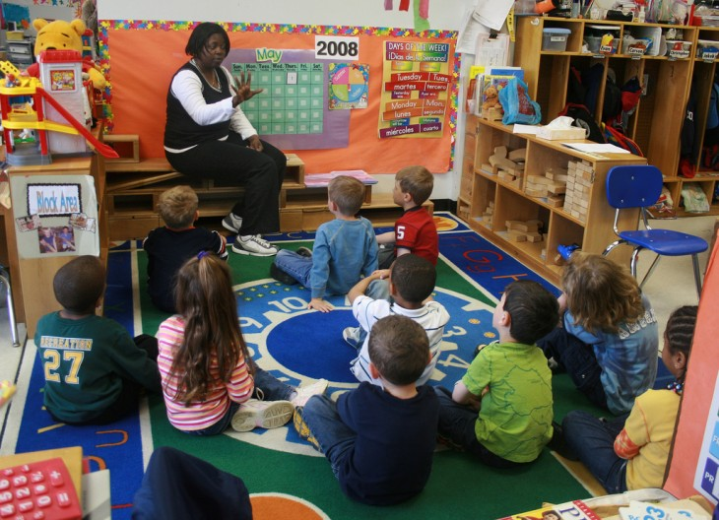
III. What an American Student Learns
Elementary School
grades kindergarten(K) through 8 (in some places, includes only grades K – 6).

Slide 11
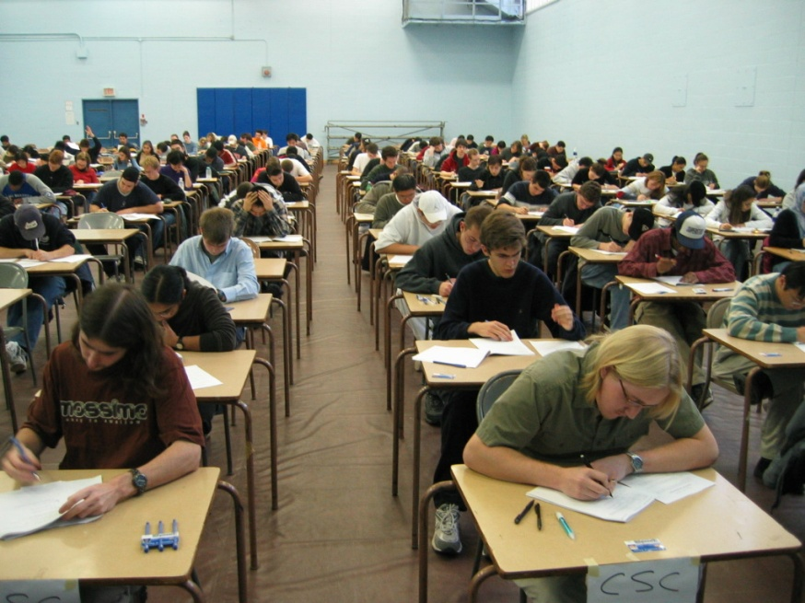
Secondary school
grades 9 – 12, popularly called “high school”;
“junior high school” includes grades 7 – 9;
“senior high school” usually includes grades 9 – 12.

Slide 12
Curriculum
Elementary school
mathematics; language arts; penmanship; science; social studies; music; art; and physical education.
some schools offer computer courses, or a second language course

Slide 13
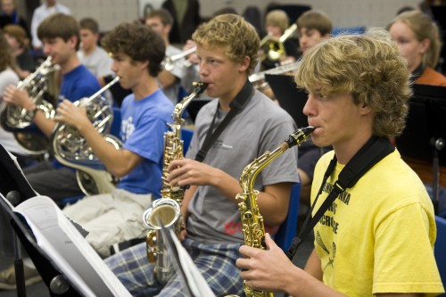
Secondary school
• required subjects: English, mathematics, science, social studies
and physical education
• School boards differ greatly from one district to another in the
amount of class time students spend on these basic subjects.

Slide 14
Elective courses
Electives can range from specialized academic to vocational subjects;
e.g. a student finishes required units American history,
he/she can take electives European history or world
political issues.
Some high schools specialize in particular types of subjects -- business education, or industrial trades, or foreign languages.

Slide 15
IV. Education in a New Nation
In Massachusetts
• The Puritans founded the Massachusetts Bay Colony in 1630;
They believed that every person should be able to read the
Bible, and set up a system of education in the colony, eg.
-- In 1636, Harvard College was founded;
-- In 1634 and 1638, passed laws using tax to support schools;
The Puritans introduced two practices: compulsory education for all children and public taxation for schools.

Slide 16
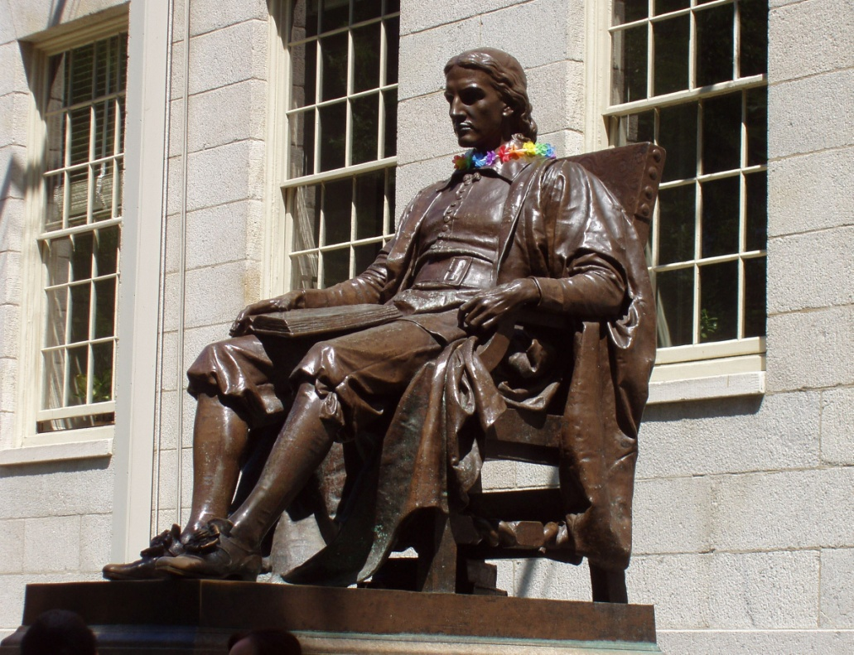
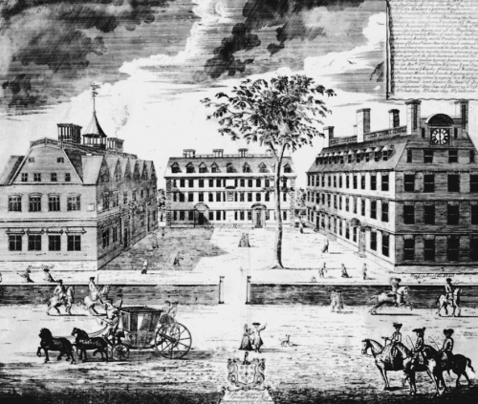
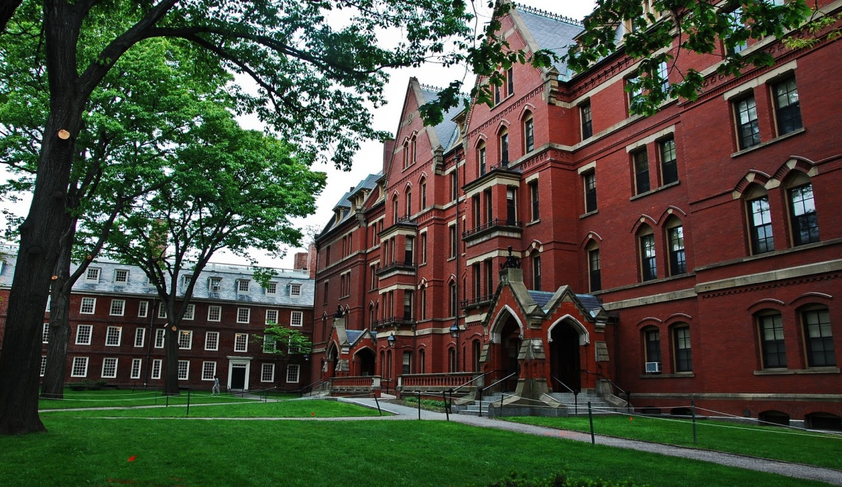
The statue of John Harvard, founder of Harvard University
Harvard University: then and now

Slide 17
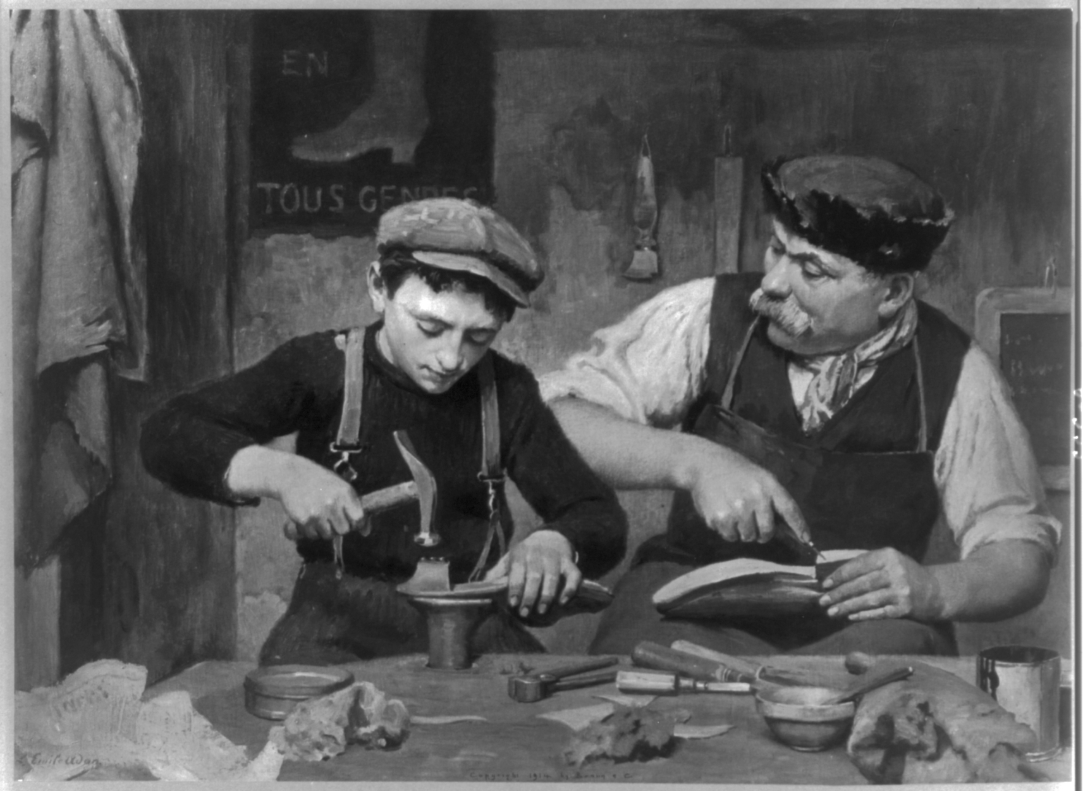
In other colonies
In Pennsylvania, decisions about education were left to the leaders of each church.
In southern colonies, the rich hired tutors for their children, or sent them to England for their education.
Throughout the colonies, young people could learn reading by becoming an apprentice.

Slide 18
The 10th amendment to the Constitution guarantees that certain power remains in the states.
At the end of the 18th century, and till now, elementary education in the U.S. was and is in local hands.

Slide 19
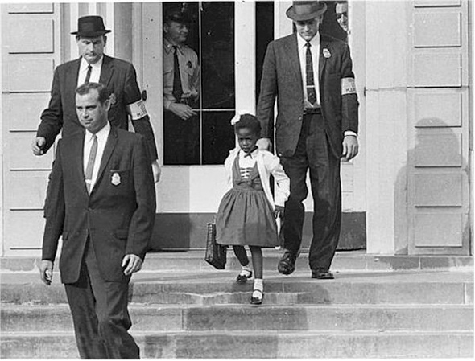
V. Learning to Be World Citizens
The postwar political, social, economic and technological changes had impacts on education.
The Supreme Court ruled that the practice of segregating blacks into separate schools was unconstitutional. (1954)
U.S. Marshals escorted Ruby Bridges to an all-white school on
Nov. 14, 1960.

Slide 20
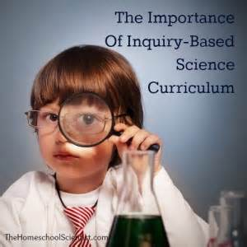
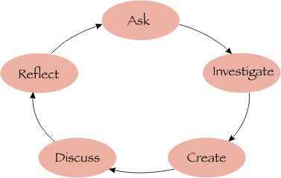
The "inquiry" method of learning, focusing on solving problems rather than memorizing facts, became popular.
More science courses were added to the curriculum.
Federal government spending on education increased.

Slide 21
VI. Higher Education
• About one third of high school graduates go on to university.
• Students are admitted into college on the basis of: a) their high school records; b) recommendations from their high school teachers; c) the impression they make during interviews at the university; and d) their scores on the SATs.

Slide 22
Higher education system in the US
Four categories of institutions --
1. the university, which may contain:
a) several colleges for undergraduate students
b) one or more graduate schools for master's or a doctoral degree;
2. the four-year undergraduate institution -- the college;
3. the technical training institution
4. the two-year, or community college.

Slide 23
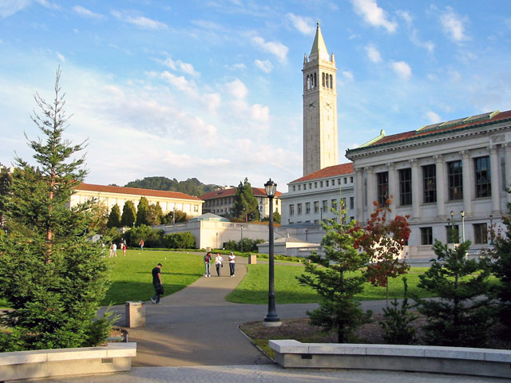
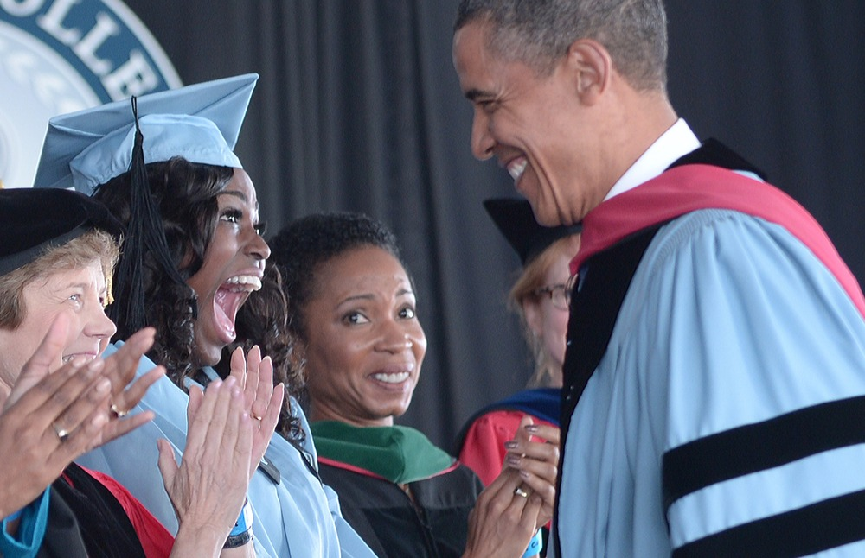
University of California ,Berkeley
President Obama attending Barnard College Commencement

Slide 24
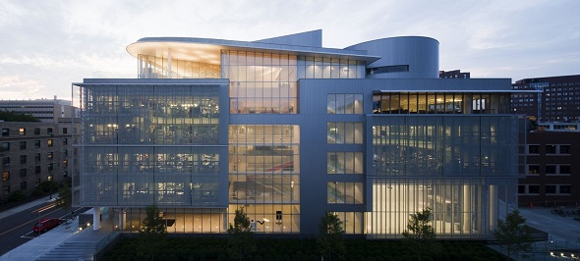
Higher education institutions might be publicly or privately funded.
The quality and reputation of an institution is determined by its teaching faculty, research facilities; amount of funding, special programs, and how selective the institution can be in choosing its students.
MIT’s Media Lab

Slide 25
VII. Selecting a College or University
Things one needs to know (I):
entrance requirements
Fees
degrees offered
length of time to earn a degree

Slide 26
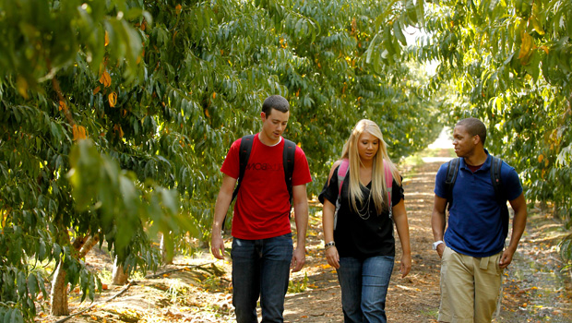
Degrees offered:
At the undergraduate (college) level, a four-year "liberal arts" course of study, or a bachelor of science (B.S.) is offered.
A technical training institution offers such courses as agriculture or business at varying lengths.
A community college studies last two years.

Slide 27
At the graduate level:
Master's and doctor's degrees are offered in both the arts and sciences.
The courses can be completed in two to four years, sometimes even longer.

Slide 28
Things one needs to know (II):
What curricula does a college or university offer?
“major”
“electives”
What are the requirements for earning a degree?
a certain number of "credits".
a "semester” of 10 to 16 weeks

Slide 29
Things one needs to know (III):
Is the college or university a public institution or a private one?
If it is private, is it a religious school?
All colleges depend on 3 sources of income
student tuition
endowments
government funding

Slide 30
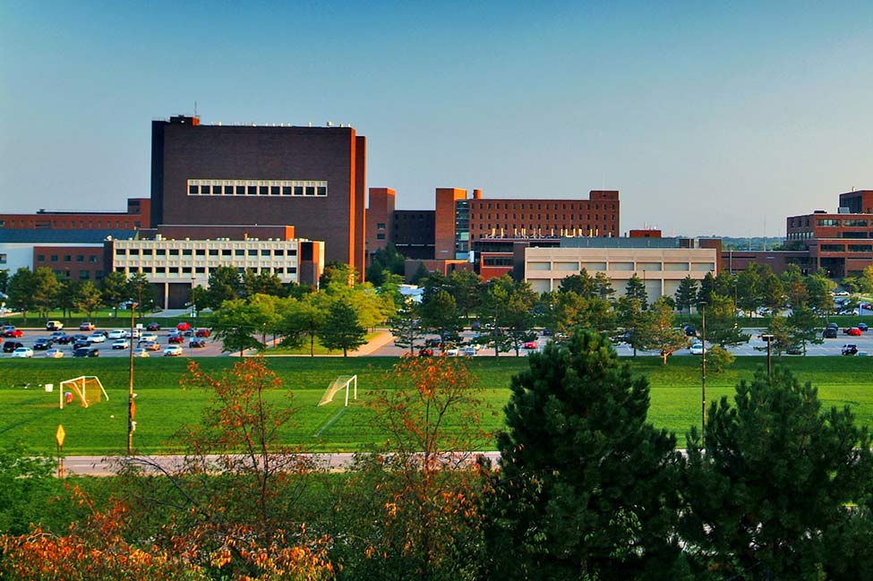
Things one needs to know (IV)
How large is the school?
-- Some universities have over 100 000 enrollments, and
dozens of campuses.
-- Large universities offer the best libraries and facilities,
and attracts leading scholars.
State University of New York at Buffalo

Slide 31
VIII. Trends in Degree Programs
During the 1970s and 1980s, there was a trend away from the traditional liberal arts for pre-professional degrees, preparing students for specific jobs.
But in recent years, there is a new popularity of liberal arts which shows a return to the early traditions of American education.

Slide 32
IX. Education for All
The Servicemen's Readjustment Act / “GI Bill of Rights”
The Act promised financial aid to veterans of World War II.
By 1955, more than two million veterans had used the GI Bill of Rights to go to college.
Their outstanding success in higher
education had changed the image of
who should go to college.

Slide 33
Affirmative action programs
special plans and programs to make up for past inequality by giving special preference to members of minorities seeking jobs or admission to college.

Slide 34
Problems and solutions
Setting quotas of minority students to be admitted felt by many as another form of discrimination.
Institutions change to serve the goal of affirmative action in less controversial ways:
eg. admitting students who would add diverse talents to
the student body.

Slide 35
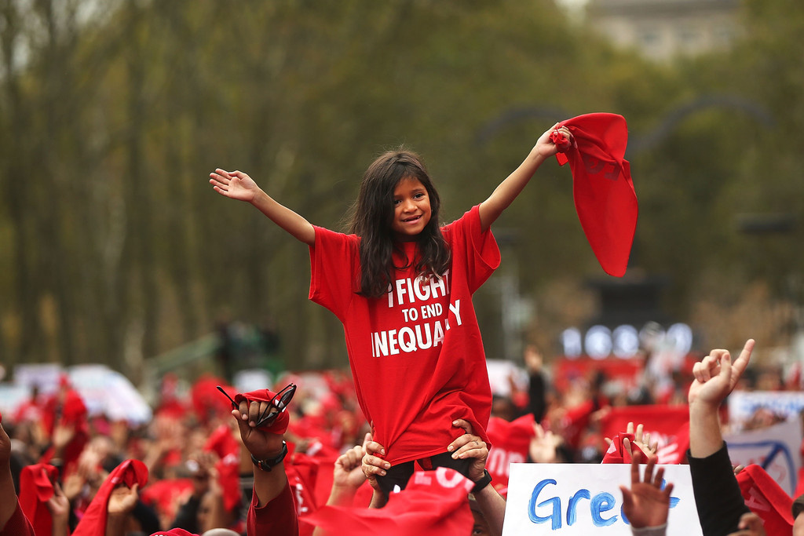
Success these efforts have:
American college students are an increasingly diverse group.
The number of Women and African-Americans who receive higher education increased.

Slide 36
Questions for Discussion
What is the goal of education in the United States? Discuss the similarities and differences in Great Britain, the United States and China concerning the goals of education.
How did American education system begin to develop?
What do you think of some of the characteristics in education that are particularly American?

Slide 37
The End
高等教育出版社
2015

